Slide 1
Problem Identification
CSC 4195 Research Methodology
3
2
Fall 2021-2022
Dr. Afroza Nahar, Associate Professor,
Department of Computer Science, Faculty of Science & Technology.
afroza@aiub.edu

Slide 2
Problem Identification
Determine a well define general problem
Sources: research articles, scientific discussion, experience, etc.
Point of interest: phenomena, theories, previous research results, etc.
Exercise your thought to express the problems
Write them as quickly as possible
Be ready, that some (may be all) of your general
problems are not researchable
Conduct literature search
Consult experts

Slide 3
No Problem No Research Agree? Or Disagree?

Slide 4
How to find research problems?
However most of it is THINKING,….THINKING…THINKING
Creative Process……
Ideas usually have roots in other ideas.
Inspirations from others.
Inspiration from other fields inside computer science, outside computer science.
Or even arts, travelling…

Slide 5
Most important is
Exchange of Ideas
A lot of research happens at conferences, workshops
Social Events more Important than Lectures
Other Forms of Collaborations (research visits, seminars)
Scientific Journals, Proceedings
Typically called international Journal of ...
Most published by scientific publishers. e.g. Elsevier, Springer, EEE ACM.

Slide 6
Most important is
Good Way of Searching Quality Scientific Articles
Look for DOI pages (Document Object Identifier)
Identifying Electronic Versions of Scientific Articles
Look at pages of publishers
Springer: Springer Link.
Elsevier: Science Direct.
ACM: ACM Digital Library
EEE: EEE Digital Library

Slide 7
Main Motivation for Doing Research
Be Inspired

Slide 8
Some Topics In Computer Science Research
Knowledge Processing
Data mining methods for linked data
Machine learning methods for semantic integration
Image Analysis
Content-based image retrieval
Fusion process
Computer vision
3D Object modeling using a range scanner
Recognizing human activities from video
Multiple-view geometry
Video content analysis
Surveillance video analysis
High-level feature extraction
Video search task

Slide 9
Some Topics In Computer Science Research
Computer-assisted education
Bio-informatics and other uses of CS in biology, biomedical engineering, and medicine
Artificial intelligence and robotics
Abundant-data applications, algorithms, and architectures
Databases, data centers, information retrieval, and natural-language processing
indexing, search on massive collection of DATA
helping computers understand human-generated documents
interactions with abundant-data applications
Emerging technologies for computing hardware, communication, and sensing:
optical and quantum computing
three-dimensional integrated circuits and a variety of new memory chips
Modeling and using new types of electronic switches
quantum communication and cryptography

Slide 10
Some Topics In Computer Science Research
Human-computer interaction
H-C interface design to detect emotions, intent, level of skill)
design of human-facing software (social networks) and hardware (talking smart-phones and self-driving cars)
Large-scale networking:
high-performance hardware for data centers
mobile networking
support for more efficient multicast
high-level user-facing services (social networks), networking services for developing countries (without permanent high-bandwidth connections)
Outer-space communication networks.
Network security is also a big deal.

Slide 11
Some Topics In Computer Science Research
Multimedia:
graphics, audio , video – analysis, compression, generation, playback, multi-channel communication etc.
synthesizing realistic multimedia, etc.
Programming languages and environments: a
Automated analysis of programs in terms of correctness and resource requirements
Software support for languages, program optimization, support for parallel programming,
Security of computer systems and support for digital democracy
network-level security
OS-level security
physical security (biometrics, tamper-proof packaging, trusted computing on untrusted platforms),
support for personal privacy (efficient and user-friendly encryption),

Slide 12
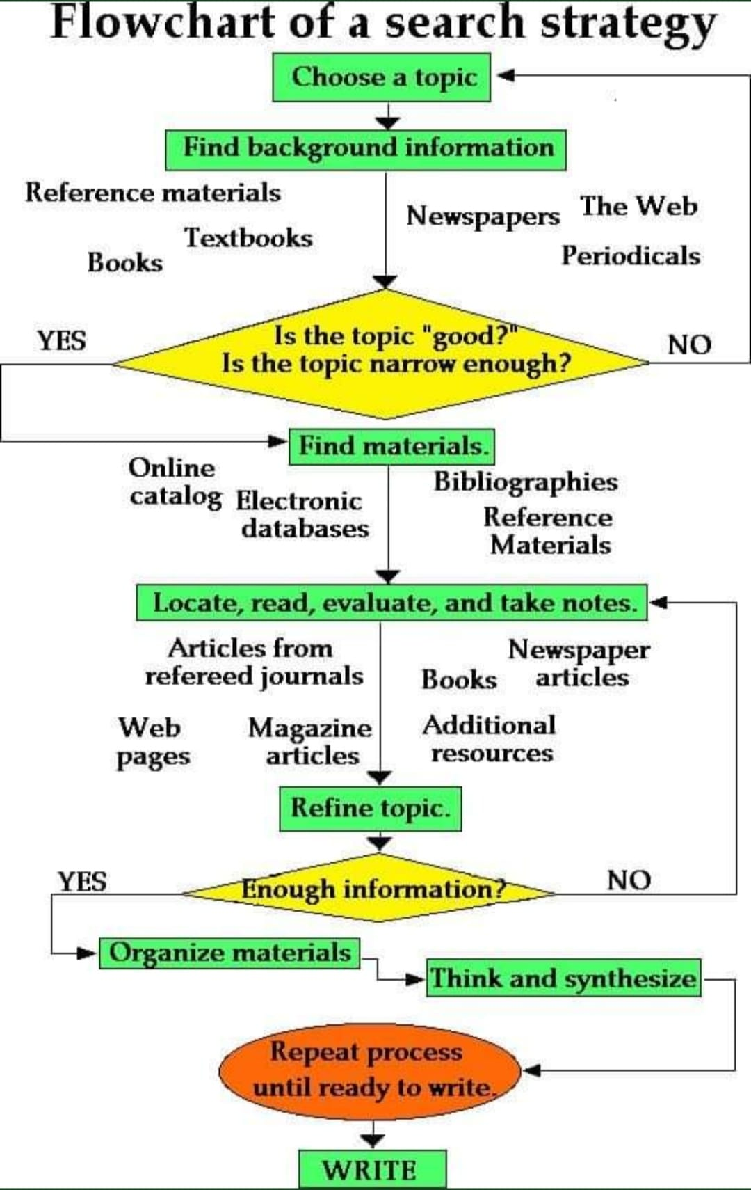

Slide 13
A Search Steps
Identification Research Problem
Identification Scope of Research
Identification Research Questions
Identification Research Objectives
Hypothesis
(tentative solution of your problem(s))

Slide 14
Example
Research Question: What is the impact of on-job training employee performance?
Specific Objective: To examine the impact of on-job training employee performance.
Hypothesis: On-job training has positive and significant impact of on-job training employee performance.
As a general Rule:
Research question, research objective and hypothesis explain similar issue.

Slide 15
Determine Research Objectives
Make sure you have a strong reason why such research is worth of doing
Study the impact?
Study the usage?
Etc.
Research objective should reflect the solution of the problem
If you can not state the problem, you can not state the objective
Build your reasons based on facts (previous studies, existing problems, etc.)

Slide 16
Hypothesis
Basically, there are two types of hypotheses:
Hypothetical statement
Statistical hypothesis
Hypothetical statement does not use statistical analysis
Usually using a qualitative approach
Statistical hypothesis uses statistical analysis.
Using a quantitative approach.
SEC:L

Slide 17
Types of methodologies
QuaLitative Measures
Descriptive
Numbers not the primary focus
Interpretive, ethnographic, naturalistic
QuaNtitative Measures
N for numbers
Statistical
Quantifiable
N B: Ethnography is a form of field research that seeks to learn the culture of a particular setting or environment. It often relies on participant observation through prolonged field work and may include other qualitative and quantitative methods..

Slide 18
Ethnography is a form of field research that seeks to learn the culture of a particular setting or environment. It often relies on participant observation through prolonged field work and may include other qualitative and quantitative methods.
Today, ethnography is a common approach in various social science fields, not just anthropology. It is used not only to study distant or unfamiliar cultures, but also to study specific communities within the researcher's own society.
Naturalistic inquiry involves the study of a single case, usually a self-identified group or community. Self-identified group members are conscious of boundaries that set them apart from others. When qualitative (naturalistic) researchers select a case for study, they do so because it is of interest in its own right.
Case study
Comparative studies
Retrospective studies
Snapshots
Longitudinal studies
Ethnography
Grounded theory
Biography
Phenomenology

Slide 19
Types of methodologies
Inductive logical of thinking
The principle of reasoning to a conclusion about
all the members of a class from examination of only a few members of the class Reasoning from particular to general
Deductive logical of thinking
Reasoning from general to particular
Conclusion follows from the premises
The premises logically imply the conclusion

Slide 20
Types of methodologies
Deductive reasoning: if something is true of a class of things in general, it is also true for all members of that class.
Inductive reasoning is the opposite of deductive reasoning.
Inductive reasoning makes broad generalizations from specific observations. "In inductive inference, we go from the specific to the general.

Slide 21
Deductive Reasoning
Deductive Reasoning – A type of logic in which one goes from a general statement to a specific instance.
The classic example
All men are mortal. (major premise)
Socrates is a man. (minor premise)
Therefore, Socrates is mortal. (conclusion)
The above is an example of a syllogism.

Slide 22
Deductive Reasoning
Syllogism: An argument composed of two statements or premises (the major and minor premises), followed by a conclusion.
For any given set of premises, if the conclusion is guaranteed, the arguments is said to be valid.
If the conclusion is not guaranteed (at least one instance in which the conclusion does not follow), the argument is said to be invalid.
BE CARFEUL, DO NOT CONFUSE TRUTH WITH VALIDITY!

Slide 23
Deductive Reasoning
Examples:
All students of AIUB eat pizza.
Claire is a student at AIUB.
Therefore, Claire eats pizza.
2. All athletes work out in the gym.
Barry Bonds is an athlete.
Therefore, Barry Bonds works out in the gym.

Slide 24
Deductive Reasoning
All CS teachers are over 7 feet tall.
Mr. X. is a CS teacher.
Therefore, Mr. X is over 7 feet tall.
The argument is valid, but is certainly not true.
The above examples are of the form
If p, then q. (major premise)
x is p. (minor premise)
Therefore, x is q. (conclusion)

Slide 25
Venn Diagrams
Venn Diagram: A diagram consisting of various overlapping figures contained in a rectangle called the universe. U
This is an example of all A are B. (If A, then B.)
B
A

Slide 26
Venn Diagrams
This is an example of No A are B.
U
A
B

Slide 27
Venn Diagrams
This is an example of some A are B. (At least one A is B.)
The yellow oval is A, the blue oval is B.

Slide 28
Example
Construct a Venn Diagram to determine the validity of the given argument.
All smiling cats talk.
The Cheshire Cat smiles.
Therefore, the Cheshire Cat talks.
VALID OR INVALID???

Slide 29
Example: Valid argument; x is Cheshire Cat
Things
that talk
Smiling cats
x

Slide 30
Examples
No one who can afford health insurance is unemployed.
All politicians can afford health insurance.
Therefore, no politician is unemployed.
VALID OR INVALID?????

Slide 31
Examples
X=politician. The argument is valid.
People who can afford
Health Care.
Politicians
X
Unemployed

Slide 32
Examples
Some professors wear glasses.
Mr. Einstein wears glasses.
Therefore, Mr. Einstein is a professor.
Let the yellow oval be professors, and the blue oval be glass wearers. Then x (Mr. Einstein) is in the blue oval, but not in the overlapping region. The argument is invalid.

Slide 33
Inductive Reasoning
Inductive Reasoning, involves going from a series of specific cases to a general statement. The conclusion in an inductive argument is never guaranteed.
Example: What is the next number in the sequence 6, 13, 20, 27,…
There is more than one correct answer.

Slide 34
Inductive Reasoning
Here’s the sequence again 6, 13, 20, 27,…
Look at the difference of each term.
13 – 6 = 7, 20 – 13 = 7, 27 – 20 = 7
Thus the next term is 34, because 34 – 27 = 7.
However what if the sequence represents the dates.
Then the next number could be 3 (31 days in a month).
The next number could be 4 (30 day month)
Or it could be 5 (29 day month – Feb. Leap year)
Or even 6 (28 day month – Feb.)

Slide 35
Mother: Don't give Billy that brownie. It contains walnuts, and I think Billy is allergic to walnuts. Last week he ate some oatmeal cookies with wallnuts and he broke out in a severe rash.
Father: Billy isn't allergic to walnuts. Don't you remember he ate some walnut fudge ice cream at Melissa's birthday party last spring? He didn't have any allergic reaction then.
Is the father's argument deductive or inductive? How can you tell?
Go to next slide

Slide 36
Mother: Don't give Billy that brownie. It contains walnuts, and I think Billy is allergic to walnuts. Last week he ate some oatmeal cookies with wallnuts and he broke out in a severe rash.
Father: Billy isn't allergic to walnuts. Don't you remember he ate some walnut fudge ice cream at Melissa's birthday party last spring? He didn't have any allergic reaction then.
Inductive.
The father's argument is a causal argument, which is a common pattern of inductive reasoning. Also, the conclusion does not follow necessarily from the premises. (Billy might have developed an allergic reaction to walnuts since last spring.)
Go to next slide

Slide 37
Larry: Do you think Representative Porkmeister will be re-elected?
Norman: I doubt it. Porkmeister's district has become more conservative in recent years. Porkmeister is a liberal Democrat, and 63% of the registered voters in his district are now Republicans.
Is this argument deductive or inductive? How can you tell?
Go to next slide

Slide 38
Larry: Do you think Representative Porkmeister will be re-elected?
Norman: I doubt it. Porkmeister's district has become more conservative in recent years. Porkmeister is a liberal Democrat, and 63% of the registered voters in his district are now Republicans.
Inductive.
This argument is both a statistical argument and a predictive argument, which are two common patterns of inductive reasoning. Also, the conclusion does not follow necessarily from the premises.
Go to next slide

Slide 39
If Buster walked to the game, then he didn't drive to the game. Buster didn't drive to the game. Therefore, Buster walked to the game.
Is this argument deductive or inductive? How can you tell?
[Go to next slide.]

Slide 40
If Buster walked to the game, then he didn't drive to the game. Buster didn't drive to the game. Therefore, Buster walked to the game.
Deductive.
This argument is a hypothetical syllogism, which is a common pattern of deductive reasoning.
Note, however, that the conclusion does not follow logically from the premises. (Maybe Buster rode his bike to the game, for example.) The argument commits the fallacy of "affirming the consequent."
[This is the end of this tutorial.]

Slide 41
THANK YOU!
NEXT: How to review literatures ……

